Slide 1
Detection of Parabolic Weld Defects from TOFD Scans
Roopsa Sen
2nd year, QEDM, Industrial Engineering
IIT Kharagpur
7 December 2021 - 14 December 2021

Slide 2
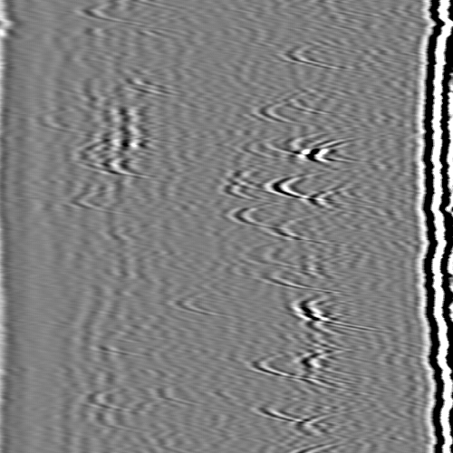
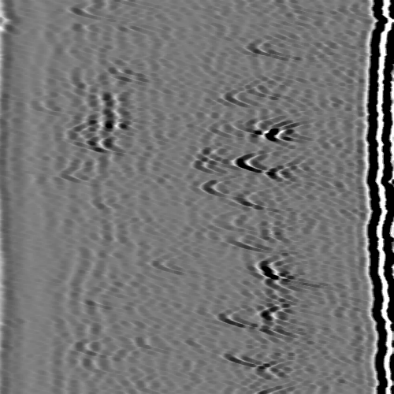
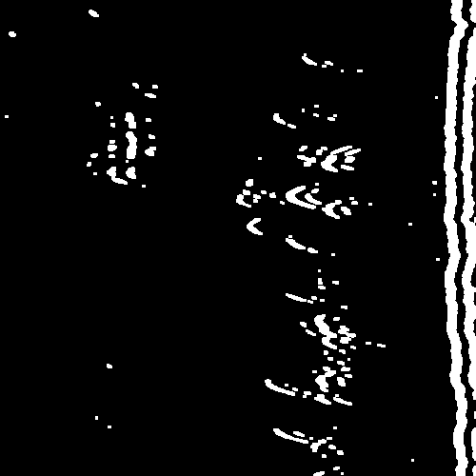
Detection of defective regions
Original Erode Adaptive Thresholding

Slide 3
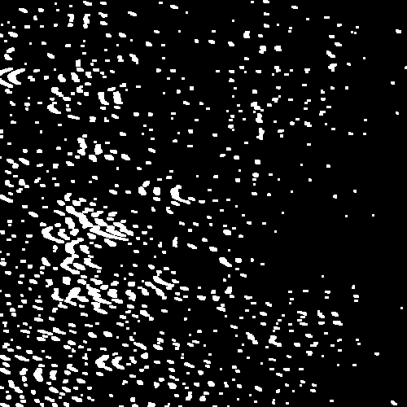
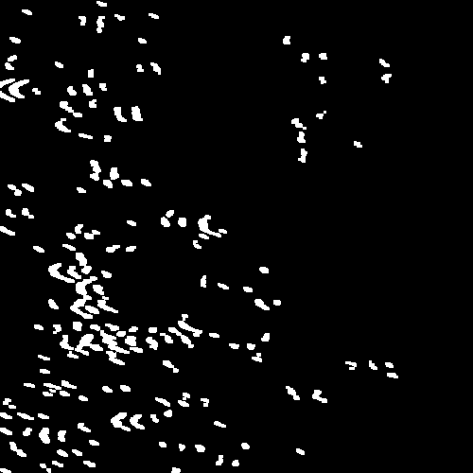
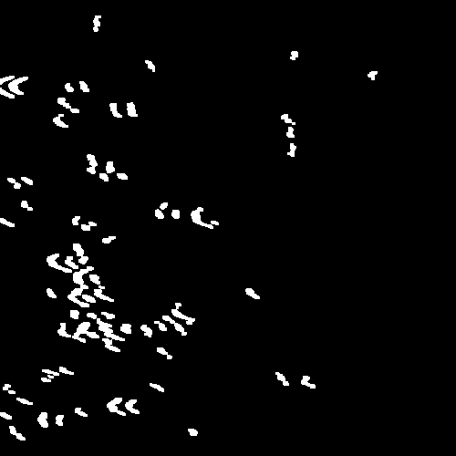
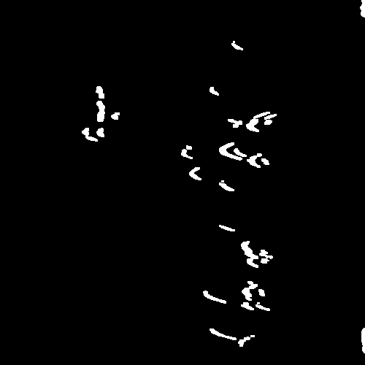
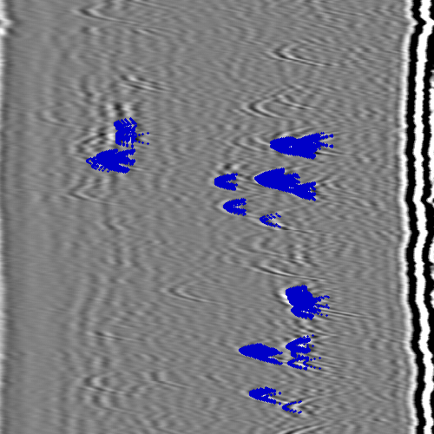
Detection of defective regions
Area Contouring Hough Parabola Original(for comparison)

Slide 4
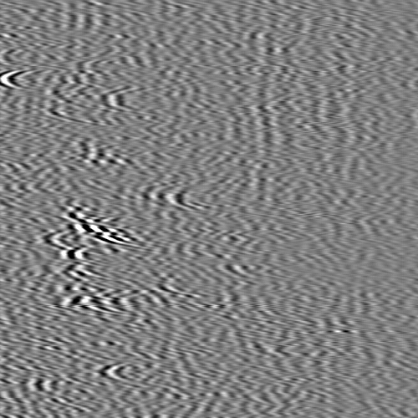
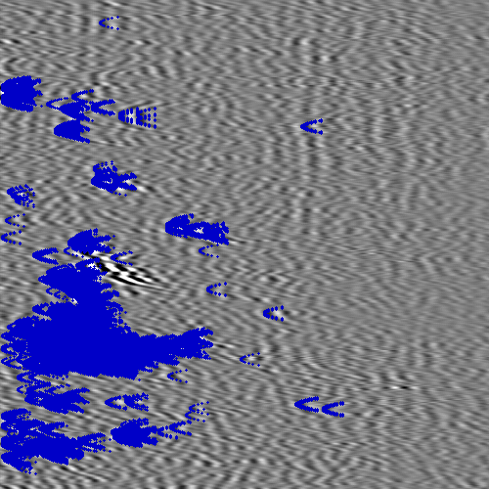
Detection of defective regions
- Problem: Extra Parabolas Detected in Noisy Regions
Original Area Contouring Hough Parabola

Slide 5
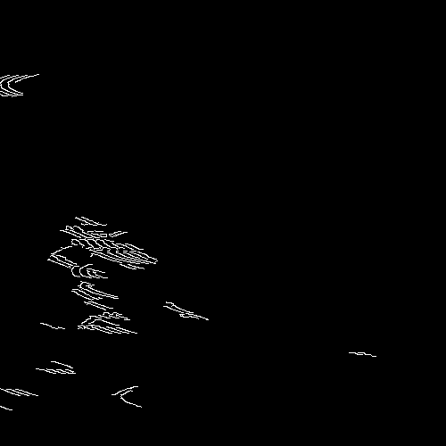
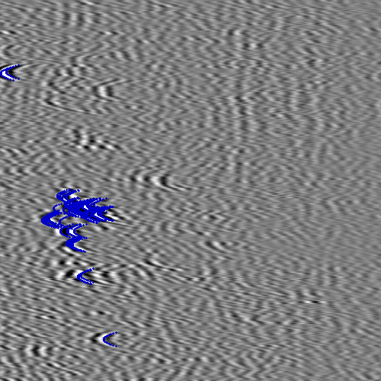
Other Approaches
Adaptive Canny, working better in noisy regions
Original Adaptive Canny Hough Parabola

Slide 6
Other Approaches
Problem: Both edges of parabolas not always detected

Slide 7
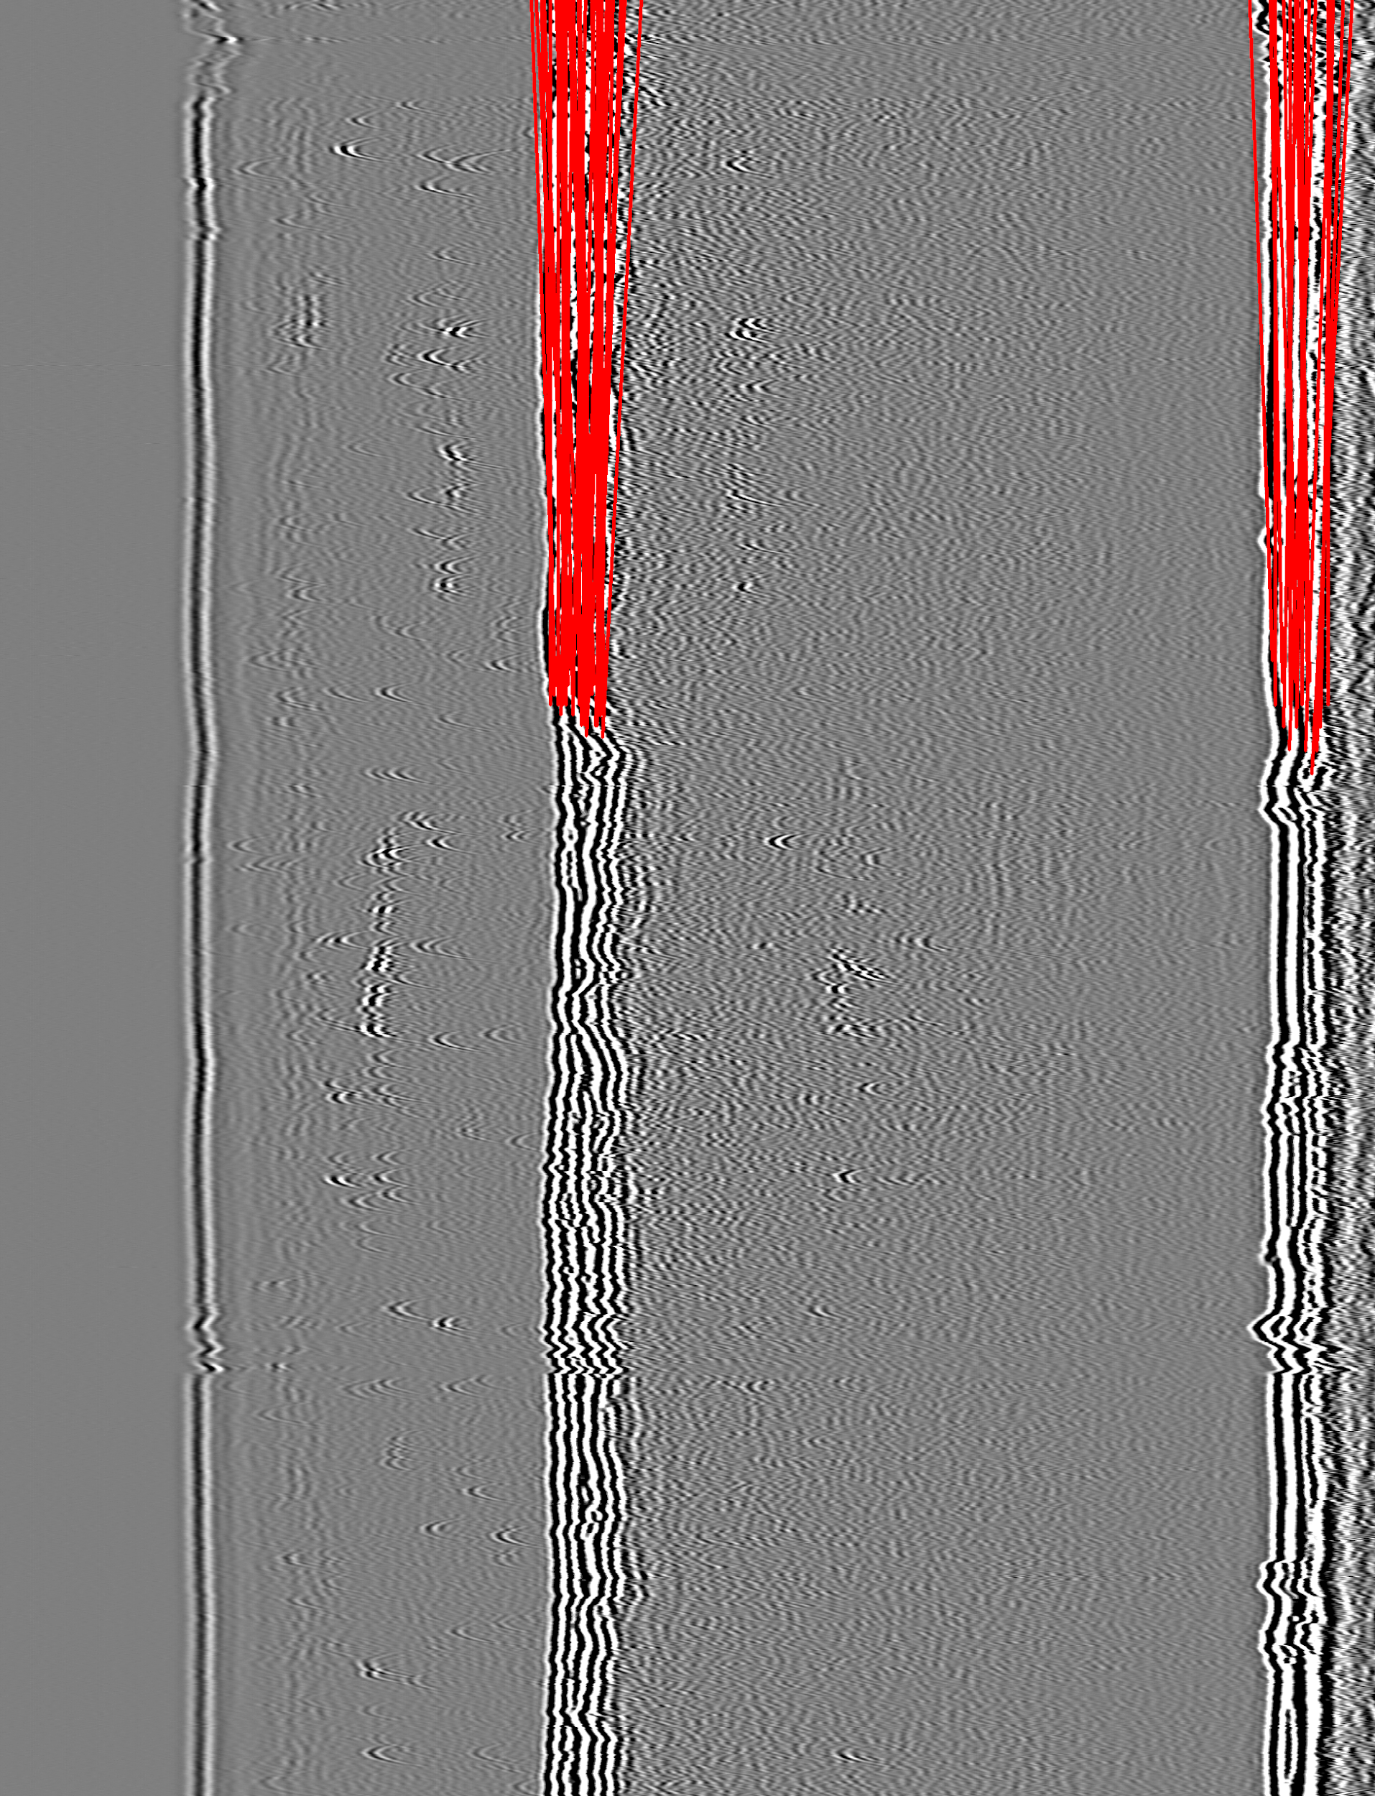
Other Approaches
Removal of echo lines through Hough Lines to reduce noise, then applying initial method

Slide 8
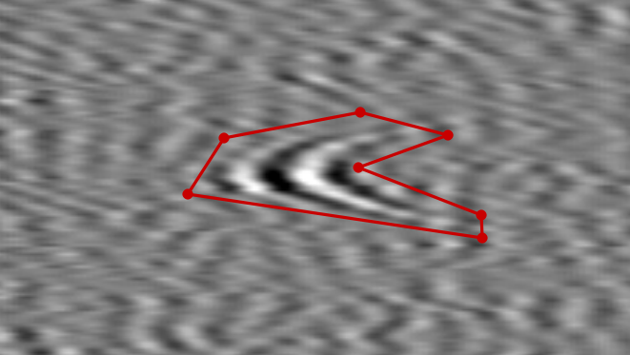
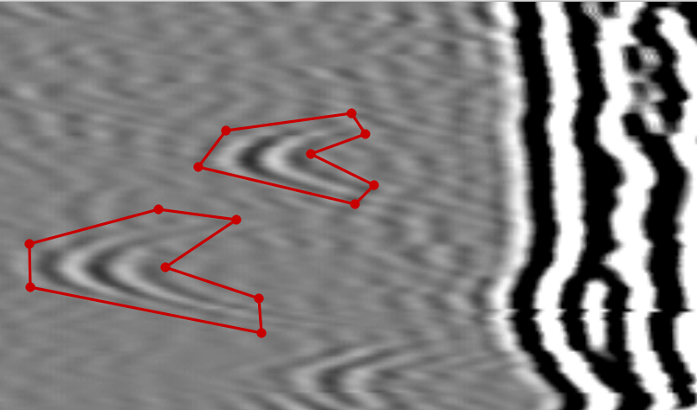
Next steps
Using Mask RCNN to detect defective regions
Improving on image processing work using area morphology or wave decomposition

